Slide 1
Routing and Forms
By Prof. Soleha. A. Sayyed

Slide 2
Client-side routing:
Client-side routing in React allows a web application to display different components or pages without reloading the entire webpage.
It makes React applications feel faster and more like traditional multi-page websites.
The most commonly used library for routing in React is React Router.
Why use Client-Side Routing?
Navigation happens without a full page refresh.
Provides a faster and smoother user experience.
Allows different URLs for different components.
Makes it easy to create Home, About, Contact, Login, etc. pages.
React Router Example
First, install React Router:
npm install react-router-dom

Slide 3
Example:
import { BrowserRouter, Routes, Route, Link }
from "react-router-dom";
function Home() {
return <h2>Home Page</h2>;
}
function About() {
return <h2>About Page</h2>;
}
function Contact() {
return <h2>Contact Page</h2>; }
function App() {
return (
<BrowserRouter>
<nav> <Link to="/">Home</Link> |{" "}
<Link to="/about">About</Link> |{" "}
<Link to="/contact">Contact</Link> </nav>
<Routes>
<Route path="/" element={<Home />} />
<Route path="/about" element={<About />} />
<Route path="/contact" element={<Contact />} />
</Routes>
</BrowserRouter> ); }
export default App;

Slide 4
Using React Router
React Router is a standard library for routing in React.
It allows you to handle routes declaratively.
It enables dynamic routing, which means that your application can modify its routes based on the application's state or user interactions.
It supports everything from basic routing to nested routes, route parameters, and authenticated routes.
Steps to Implement React Router
Step 1: Create a react app by using the following command.
npx create-react-app routing
cd routing
Step 2: Install the required dependencies.
npm install react-router-dom

Slide 5
Example:
//App.js
import React from 'react';
import { BrowserRouter, Routes, Route, Link } from 'react-router-dom';
import Home from './home';
import About from './about';
import Contact from './contact';
function App() {
return (
<div>
<BrowserRouter>
<nav>
<Link to="/">Home</Link>|{" "}
<Link to="/about">About Us</Link>|{" "}
<Link to="/contact">Contact Us</Link>
</nav>
<Routes>
<Route path="/" element={<Home />} />
<Route path="/about" element={<About />} />
<Route path="/contact" element={<Contact />} />
</Routes> </BrowserRouter>
</div>
); }
export default App;

Slide 6
Continue….
//Home.jsx
import React from 'react';
function Home() {
return (
<div>
<h1>Welcome to my app!</h1>
<p>This is the home page.</p>
</div>
);
}
export default Home;
//About.jsx
import React from 'react';
function About() {
return (
<div>
<h1>About Us</h1>
<p>Learn more about
our company and mission.</p>
</div>
);
}
export default About;
//Contact.jsx
import React from 'react';
function Contact() {
return (
<div>
<h1>Contact Us</h1>
<p>Get in touch with us.</p>
</div>
);
}
export default Contact;

Slide 7
React Router Pros and Cons:
Pros:
Organized Code: It keeps your app structure logical and maintainable.
Declarative Routing: It has simple setup, intuitive path definitions.
Dynamic URLs: It has powerful navigation based on user interactions or data.
SEO-friendly: Supports SSR and SSG for better search visibility.
Large Community & Ecosystem: Plenty of resources and solutions available.
Cons:
Learning Curve: Requires some effort to understand the concepts and API.
Boilerplate Code: Initial setup might involve repetitive code.
Performance Overhead: Adds a slight overhead compared to manual routing.
Complex for Large Apps: Managing extensive navigation can get intricate.

Slide 8
Navigation in React
Navigation in React allows users to move between different components or views in a Single Page Application without reloading the page, using client-side routing for smooth transitions.
Navigation happens without reloading the entire page, making the application faster and smoother.
Routing is handled on the client side instead of requesting new pages from the server.
It improves user experience by providing quick and seamless view changes.
React Router is commonly used to manage navigation between components.
Syntax
// Installing
npm i react-router-dom
// Importing
import { BrowserRouter } from 'react-router-dom';
Installing: npm i react-router-dom installs React Router for routing in React.
Importing: import { BrowserRouter } from 'react-router-dom'; imports BrowserRouter to enable routing in your app.

Slide 9
Programmatically Navigate in React
Programmatic navigation allows you to navigate between different routes based on actions, such as button clicks or form submissions.
This method provides more control over routing, enabling navigation in response to events triggered by the user.
React navigation using useNavigate allows users to programmatically move between pages or components in a Single Page Application without reloading the page.
Create 2 basic pages between which you want to redirect.
Create buttons on each page to redirect the user.
Import the useNavigate hook provided with react-router-dom.
Use this hook on the onClick event button to redirect.

Slide 10
Example:
// App.js
import { BrowserRouter, Routes, Route } from "react-router-dom";
import "./App.css";
import AboutUs from "./components/AboutUs";
import ContactUs from "./components/CotactUs";
function App() {
return (
<div className="App">
<BrowserRouter>
<Routes>
<Route exact path="/" element={<AboutUs />} />
<Route exact path="/contactus" element={<ContactUs />} />
</Routes>
</BrowserRouter>
</div>
);
}
export default App;

Slide 11
Example:
// AboutUs.js
import React from "react";
import { useNavigate } from "react-router-dom";
function AboutUs() {
const nav = useNavigate();
return (
<div>
<h2>Wecome to Abeda Inamdar Senior College</h2>
Read more about us at :
<a href="https://www.abedainamdarcollege.org.in/about_us">
https://www.abedainamdarcollege.org.in/
</a>
<br></br>
<br></br>
<button
onClick={() => {
nav("contactus");
}}
>
Click Here to check contact details
</button>
</div>
);
}
export default AboutUs;

Slide 12
Example:
// ContactUs.js
import React from "react";
import { useNavigate } from "react-router-dom";
function ContactUs() {
const nav = useNavigate();
return (
<div>
<address>
You can find us here:
<br />
Abeda Inamdar Senior College
<br />
GV4G+7JW, Hidayatulla Rd, Katad Khana, Pune, Maharashtra 411001
02026446979
</address>
<br></br>
<br></br>
<button
onClick={() => {
nav(-1);
}}
>
Click Here to Go Back to website
</button>
</div>
);
}
export default ContactUs;

Slide 13
Dynamic Routing with React router
Adding Link routes gets very lengthy when there are multiple pages, so we use the concept of Dynamic Routing to reduce the lines of code and make the code shorter.
Dynamic routing allows you to define routes dynamically based on certain conditions.
Dynamic routing in React allows passing parameters through URLs, enabling components to render content based on route-specific data using useParams.
Create a page which will create Link components using map.
Create a page which will display data dynamically using useParams.
Create a dynamic Route component which passes the id as a parameter. It comes under the component folder.

Slide 14
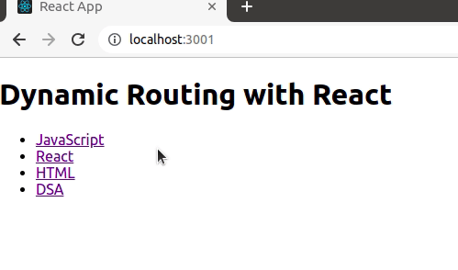
Example:
App.jsx
import { BrowserRouter, Routes, Route, Link } from "react-router-dom";
import CourseDetails from "./coursedetails";
function App() {
const courses = ["JavaScript", "React", "HTML", "DSA"];
return (
<BrowserRouter>
<h1>Dynamic Routing with React</h1>
<ul>
{courses.map((course) => {
return (
<li key={course}>
<Link to={`courses/${course}`}>{course}</Link>
</li>
);
})}
</ul>
<Routes>
<Route path="courses/:courseId" element={<CourseDetails />} />
</Routes>
</BrowserRouter>
); }
export default App;0
Coursedetails.jsx
// components/CourseDetails.js
import { useParams } from "react-router-dom";
function CourseDetails() {
const { courseId } = useParams();
return (
<div>
<h1>This is {courseId} course</h1>
</div>
);
}
export default CourseDetails;

Slide 15
Forms in React
In React, forms are used to take input from users, like text, numbers, or selections.
They work just like HTML forms but are often controlled by React state, so you can easily track and update the input values.
Forms in React can be easily added and used as a simple react element.
Inputs in React can be either controlled or uncontrolled, with controlled being the more common approach.
Form submission is handled using an onSubmit event handler, where event.preventDefault() is called to stop the browser from reloading the page.

Slide 16
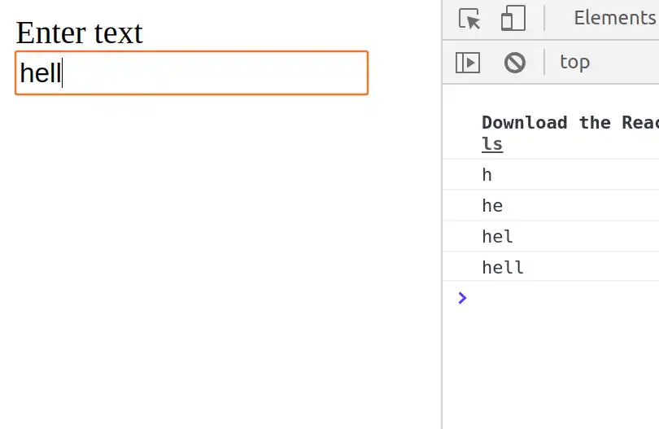
Example:
import React from "react";
import ReactDOM from "react-dom";
function App() {
function onInputChange(event) {
console.log(event.target.value);
}
return (
<div>
<form>
<label>Enter text</label>
<input
type="text"
onChange={onInputChange}
/>
</form>
</div>
);
}
ReactDOM.render(<App />, document.querySelector("#root"));

Slide 17
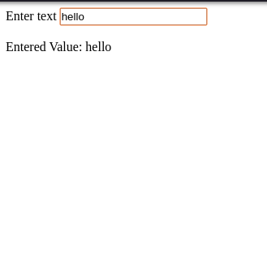
Handling React Forms
In HTML the HTML DOM handles the input data but in react the values are stored in state variable and form data is handled by the components.
Example
import React, { useState } from "react";
import ReactDOM from "react-dom";
function App() {
const [inputValue, setInputValue] = useState("");
return (
<div>
<form>
<label>Enter text</label>
<input
type="text"
value={inputValue}
onChange={(e) => setInputValue(e.target.value)}
/>
</form>
<br />
<div>
Entered Value: {inputValue}
</div> </div> ); }
ReactDOM.render(<App />, document.querySelector("#root"));

Slide 18
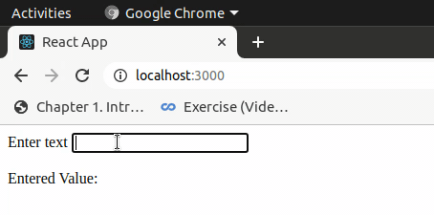
Submitting React Forms
The submit action in React form is done by using the event handler onSubmit which accepts the submit function.
Example
import React, { useState } from "react";
import ReactDOM from "react-dom";
function App() {
const [inputValue, setInputValue] = useState("");
const onFormSubmit = (event) => {
event.preventDefault();
setInputValue("Hello World!");
};
return (
<div>
<form onSubmit={onFormSubmit}>
<label>Enter text</label>
<input
type="text"
value={inputValue}
onChange={(e) =>
setInputValue(e.target.value) }/>
</form>
<br />
<div>
Entered Value: {inputValue}
</div>
</div>
);
}
ReactDOM.render(<App />, document.querySelector("#root"));

Slide 19
What are Controlled Components?
A controlled component in React is an element whose state is controlled by React itself.
This means that the component's state is stored in a React component's state and can only be updated by triggering a state change via React’s setState() method.
Features of Controlled
State Management: Form data is handled by the component's state using React's useState hook or this.state in class components.
Data Flow: The input elements' values are set by the state, and any changes are reflected through state updates.
Predictability: Since the state is managed by React, the component's behavior is predictable and consistent.
Real-Time Validation: Enables immediate validation and formatting of user input.
Single Source of Truth: The state serves as the single source of truth for the form data.

Slide 20
What are Uncontrolled Components?
An uncontrolled component in React refers to a component where the form element's state is not directly controlled by React.
Instead, the form element itself maintains its own state, and React only interacts with the element indirectly through references (refs).
Features of Uncontrolled Components
DOM-Managed State: Form data is handled by the DOM itself, not by React state.
Use of Refs: Access to form values is achieved using React's useRef() or createRef() to reference DOM elements directly.
No State Management: Eliminates the need for state variables and event handlers for each input field.
Simpler Implementation: Suitable for simple forms or when integrating with non-React libraries that manipulate the DOM directly.
Less Predictable: Since the component's state is not synchronized with React, it can lead to less predictable behavior.
Manual Validation: Validation and formatting need to be handled manually, often during form submission.

Slide 21
Difference between Controlled & Uncontrolled Components:
Controlled Components | Uncontrolled Components
Uses React state as the source of truth. | Uses the DOM to maintain internal state.
Data flows from React state to input. | Data flows from the input to React only when accessed via refs.
Can validate or format input in real-time. | Validation usually occurs on form submission.
Requires more boilerplate (state and handlers). | Simpler and quicker to implement for basic cases.
May cause more re-renders, as each keystroke updates state. | Potentially better for large forms or infrequent value access.

Slide 22
Statefull and Stateless Components in React:
Stateless Components:
Stateless components, also referred to as functional components, do not hold or manage local state.
They simply accept data via props and render UI elements.
With the introduction of Hooks in React 16.8, functional components have become more powerful,
allowing them to use state and other React features without being class-based.
Characteristics of Stateless Components:
Do not have their own state (although, with Hooks, this is less clear-cut).
They are usually simpler and used for presenting static UI elements.
Easier to test and maintain due to their simplicity.
Example Use Case:
A good example is a UI component like a button or a display label.
These components receive all the data they need via props and render accordingly.
For instance, a Button component might accept props like onClick, label, and style but does not manage any state internally.
Example:
function WelcomeMessage({ name }) {
return <h2>Welcome, {name}!</h2>; }

Slide 23
Stateful Components:
Stateful components, also known as class components (traditionally), are those that manage their own state.
In React, "state" refers to an object that determines how a component renders and behaves.
Stateful components are responsible for keeping track of changing data that affects the render output of the component.
Characteristics of Stateful Components:
They can hold and manage local state.
They have lifecycle methods (like componentDidMount, componentDidUpdate, etc.).
Usually more complex than stateless components.
Example Use Case:
A classic example is a form input. Let's consider a login form with email and password fields. The form component needs to track the values of these fields, handle changes, and potentially control form submission behavior. This state management necessitates the use of a stateful component.
Counter program example where component re-renders each time the state changes.

Slide 24
React JS Form validations:
Form validation in React checks if user inputs are correct before submission. It helps in
preventing incorrect or incomplete data from being sent, improving both data accuracy and user
experience.
Manual Validation (Controlled Components):
State Management:
Use React's useState hook to manage the values of form inputs and their corresponding error
messages.
Validation Logic:
Implement functions that check the input values against your validation rules (e.g., empty fields,
email format, password strength).
Conditional Rendering:
Display error messages next to the relevant input fields based on the validation results.
Submission Handling:
On form submission, trigger the validation logic and prevent submission if errors exist.

Slide 25
Example:
import React, { useState } from 'react';
function MyForm() {
const [email, setEmail] = useState('');
const [emailError, setEmailError] =
useState('');
const validateEmail = () => {
if (!email) {
setEmailError('Email is required');
return false;
} else if (!/\S+@\S+\.\S+/.test(email)) {
setEmailError('Invalid email format');
return false;
}
setEmailError('');
return true;
};
const handleSubmit = (e) => {
e.preventDefault();
if (validateEmail()) {
alert('Form submitted successfully!');
// Further processing of form data
}
};
return (
<form onSubmit={handleSubmit}>
<label>Email:</label> <input
type="text"
value={email}
onChange={(e) =>
setEmail(e.target.value)}
onBlur={validateEmail} // Validate on blur
/> {emailError && <p style={{ color: 'red'
}}>{emailError}</p>} <button
type="submit">Submit</button> </form>
);
}
export default MyForm;

